Slide 1
Improving Language Understanding by Generative Pre-Training
Presented by Mica Haney

Slide 2
Introduction and Related Work
At the time that the paper was written, the most powerful form of representation in NLP was the word embedding. Unfortunately word embeddings only capture information on the token level.
The goal was to create a model that could generate representations that captured higher-level semantics, and that could be transferred to a downstream task.
There were similar research projects published, however the projects involved using LSTMs and the models suffered from range restriction.

Slide 3
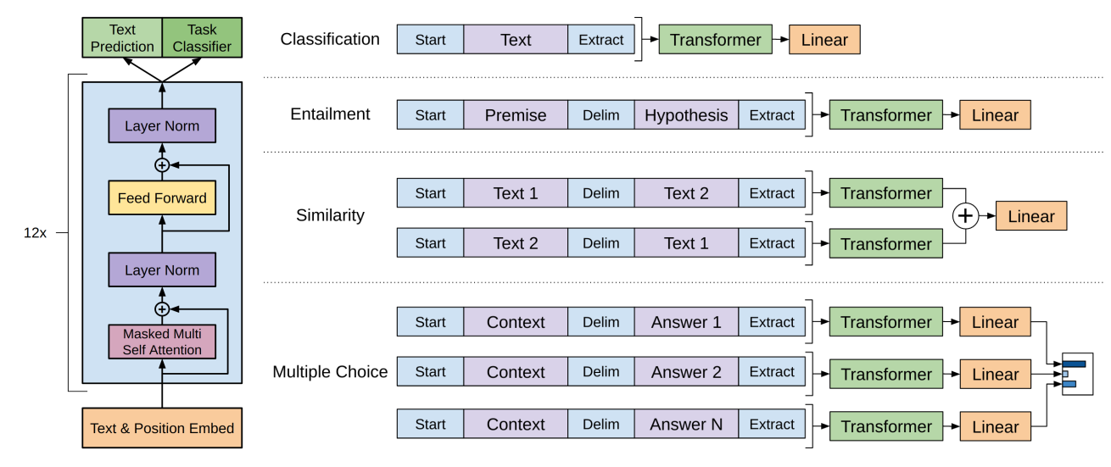
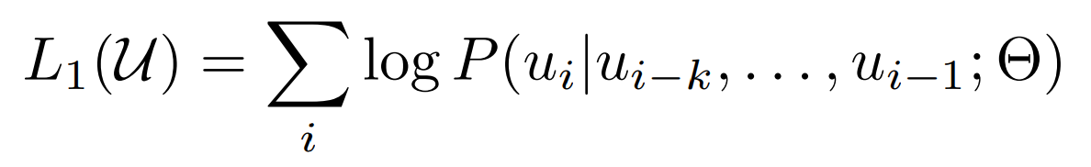
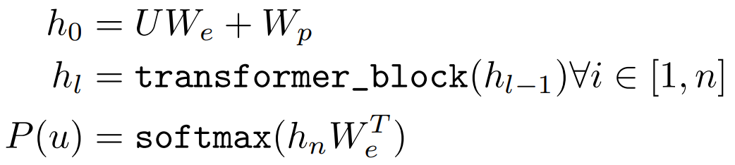
Framework - Unsupervised Pre-Training
The model works in two stages. Unsupervised pre-training is the first stage. The target task is language modeling, trained over a large corpus of text. This task is performed the same no matter what the final downstream task is.
This portion of the model uses a multi-layer transformer decoder for language modeling due to the transformer’s superior performance at handling long-range dependencies. On top of that is a position-wise feedforward layers that produces an output distribution over target tokens.
Notes:
Curly U: corpus of tokens
U: context vector of tokens
We: token embedding matrix
Wp: position embedding matrix

Slide 4
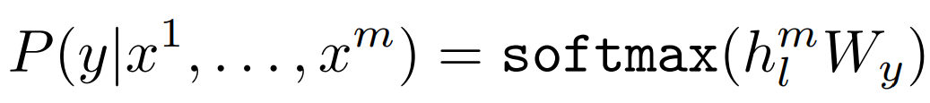
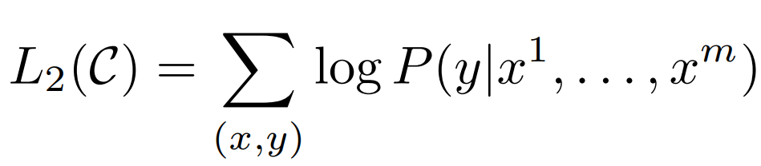
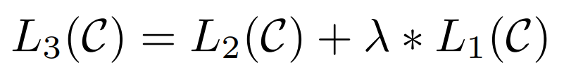
Framework - Supervised Fine-Tuning
The second stage of the model is supervised fine-tuning. This is where the approach is tailored to the supervised target task. The inputs of are passed through the pre-trained language model and the results are passed through a linear layer to predict the task’s target.
An added auxiliary task of language modeling was added during fine-tuning to aid in improving generalization and accelerate the convergence rate.
Notes:
Curly C: labeled dataset

Slide 5
Framework - Task-Specific Input Transformations
For tasks with specifically-structured inputs in the form of multiple segments of text, the strings are converted into a single sequence for the model to process. The input transformations all include a start and end token, and those with multiple segments have delimiters added between the concatenations.

Slide 6
Framework

Slide 7
Experiments - Data
Unsupervised Pre-Training:
BooksCorpus
1B Word Benchmark
Supervised Fine-Tuning:
Natural Language Inference: SNLI, MultiNLI, Question NLI, RTE, SciTail
Question Answering: RACE, Story Cloze
Sentence Similarity: MSR Paraphrase Corpus, Quora Question Pairs, STS Benchmark
Classification: Stanford Sentiment Treebank-2, CoLA

Slide 8
Experiments - Unsupervised Training Details
12-layer decoder-only transformer
12 masked self attention heads with 768 dimensional states
Adam optimizer
Max learning rate of 2.5e-4, increased linearly for the first 2000, annealed to 0 on a cosine schedule
Training over 100 epochs, minibatches of 64 random sequences of 512 tokens
BPE vocabulary with 40,000 merges
Residual, embedding, and attention dropout rates of 0.1
Modified L2 regularization
Activation function is Gaussian Error Linear Unit
Used learned position embeddings

Slide 9
Experiments - Supervised Fine-Tuning Details
Dropout classifier rate of 0.1
Learning rate of 6.25e-5, linear decay rate, warmup over 0.2% of training
Batch size of 32
3 epochs of training was usually sufficient

Slide 10
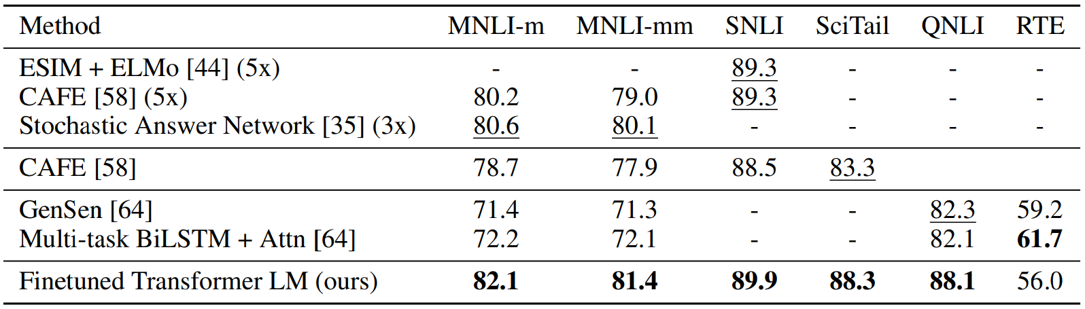
Results - Natural Language Inference
The evaluation metric is accuracy.

Slide 11
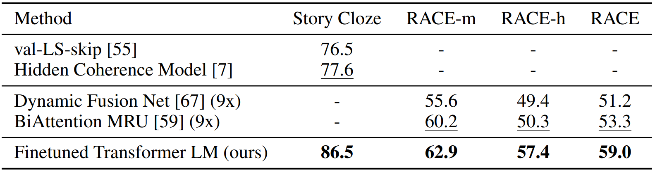
Results - Question Answering and Commonsense Reasoning
The evaluation metric is accuracy.

Slide 12
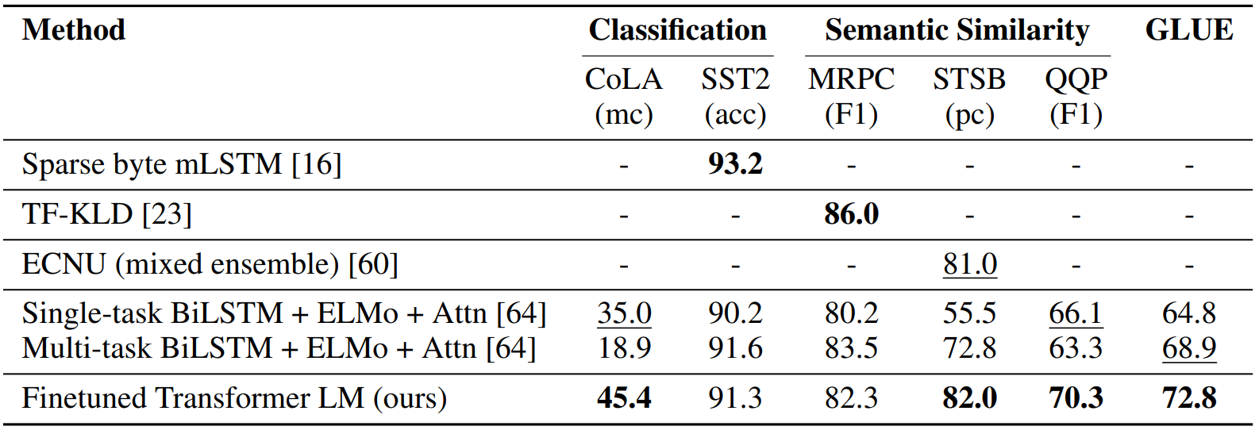
Results - Semantic Similarity and Classification
mc = Mathews correlation, acc = accuracy, pc = Pearson correlation

Slide 13
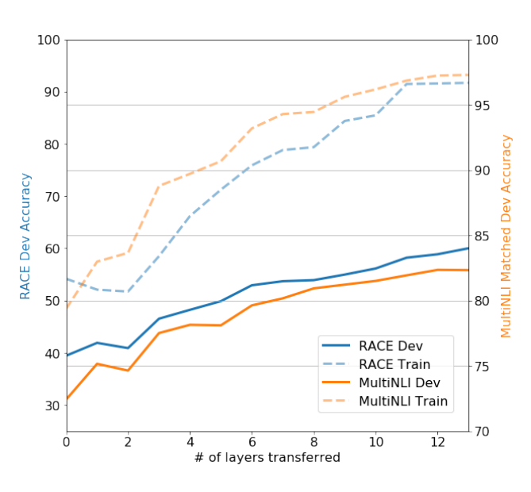
Analysis - Impact of Number of Layers Transferred
The researchers analyzed what effects changing the number of pre-trained language modeling layers had on accuracy. They found that each added layer added up to a 9% accuracy improvement on the MultiNLI score.
Notes:
RACE: Question answering
MultiNLI: natural language inference

Slide 14
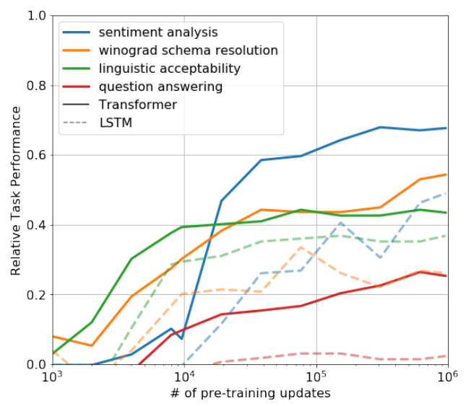
Analysis - Zero-Shot Behaviors
The researchers theorized that the model picks up many of the tasks necessary in NLU during the unsupervised learning stage. To evaluate this, the model was evaluated for zero-shot performance during the pre-training phase. A LSTM model was also evaluated on each task, and performed notably worse.

Slide 15
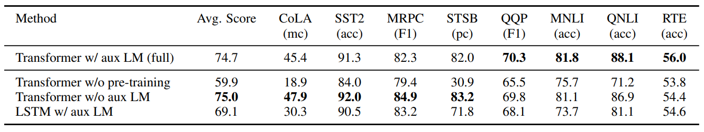
Analysis - Ablation Studies
Transformer w/o pre-training: Architecture directly trained on target tasks. Transformer w/o aux LM: Auxiliary LM objective during fine-tuning was removed. Demonstrates that large datasets benefit from LM objective while small datasets don’t. LSTM w/ aux LM: Single-layer 2048 unit LSTM of the same framework.
mc = Mathews correlation, acc = accuracy, pc = Pearson correlation

